Slide 1

University Institute of Liberal Arts and Humanities
Course Name- Communication Skills
Course Code- 23PCH-105
IDIOMS
DISCOVER . LEARN . EMPOWER

Slide 2
COURSE OBJECTIVES
The Course aims to:
1 | Augment students overall communication and interpersonal skills by making them realize the importance of good oral and written English Language in professional life.
2 | Enrich their reading capability with special emphasis on expanding vocabulary and grammatical formations.
3 | Build exceptional speaking, reading and writing skills by correcting grammatical errors and pronunciation through practice.
4 | Enhances soft skills by fostering self awareness, confidence and a positive attitude in students’ ability to communicate effectively in English.

Slide 3

COURSE OUTCOMES
On completion, the students are expected to:
CO Number | Title | Level
CO1 | Apply appropriate Listening, Speaking, Reading and Writing Skills (LSRW Skills) with correct non-verbal cues to attain expertise in soft skills. | Apply
CO2 | Apply correct contextual and comprehensible written text in the form of paragraph writing, short compositions business correspondence, using logical support and argument in a wide range of communication situations. | Apply
CO3 | Demonstrate linguistic competence while speaking and during presentations through accuracy in grammatical usage, vocabulary, pronunciation and intonation. | Apply
CO4 | Evaluate information as critical readers, speakers and writers applying ethics in communication and being sensitive in cross cultural communication. | Evaluate
CO5 | Create original, digital content for websites, blogs, vlogs and personal social media profiles etc. | Create
asmartstudyzone.blogspot.com

Slide 4
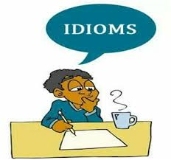
IDIOMS
Topics to be Covered:
What are Idioms?
Importance of Idioms
Usage of idioms
Different types of Idioms
Examples of Idiomatic and non Idiomatic sentences
Worksheet
english.eagetutor.com

Slide 5
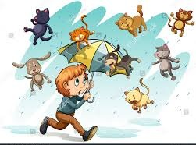
What are Idioms ?
The expressions which are having different meaning from the literal one.
Reflection of a certain cultural traditions and personalities found in idioms.
Lexical usage presents deeper meaning and understanding of the expression used.
For e.g. :- ‘ It is raining by cats and dogs’
Meaning: It is raining heavily.
Shutterstock.com

Slide 6
Importance of using Idioms
To make our conversation less monotonous by adding idioms
Help us to have the better expression of exact same idea in creative and more efficient way
Their usage enriches our language making it more impressive
Variety can be seen in the text

Slide 7
Importance of using Idioms(contd.)
For improving your speaking and writing style
Helps to say many things in just a few words
Makes the speaker confident in communicating well
For improving LSRW skills by understanding and using idiomatic expressions

Slide 8
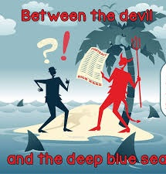
Use of idioms(contd.)
A piece of cake
Meaning- very easy task
A hard nut to crack
Meaning- a difficult task or problem to solve
Between the devil and the deep sea
Meaning- between two difficulties
Pinterest.com

Slide 9
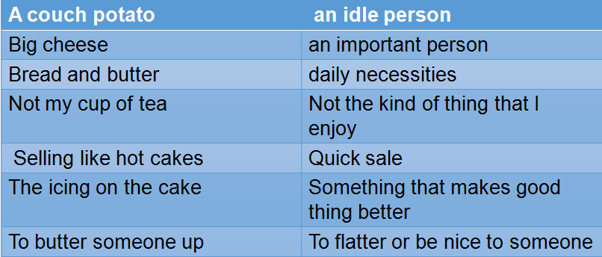
Idioms with food related words
A couch potato | an idle person
Big cheese | an important person
Bread and butter | daily necessities
Not my cup of tea | Not the kind of thing that I enjoy
Selling like hot cakes | Quick sale
The icing on the cake | Something that makes good thing better
To butter someone up | To flatter or be nice to someone

Slide 10
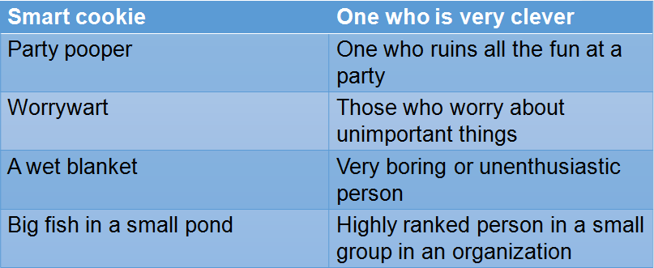
Idioms to describe persons
Smart cookie | One who is very clever
Party pooper | One who ruins all the fun at a party
Worrywart | Those who worry about unimportant things
A wet blanket | Very boring or unenthusiastic person
Big fish in a small pond | Highly ranked person in a small group in an organization

Slide 11
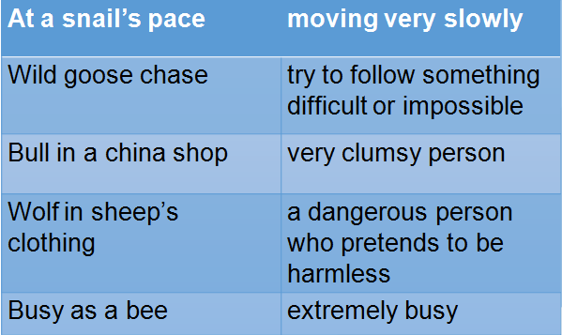
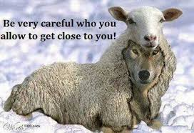
Idioms with birds/animals related words
At a snail’s pace | moving very slowly
Wild goose chase | try to follow something difficult or impossible
Bull in a china shop | very clumsy person
Wolf in sheep’s clothing | a dangerous person who pretends to be harmless
Busy as a bee | extremely busy
Pinterest.co.uk

Slide 12
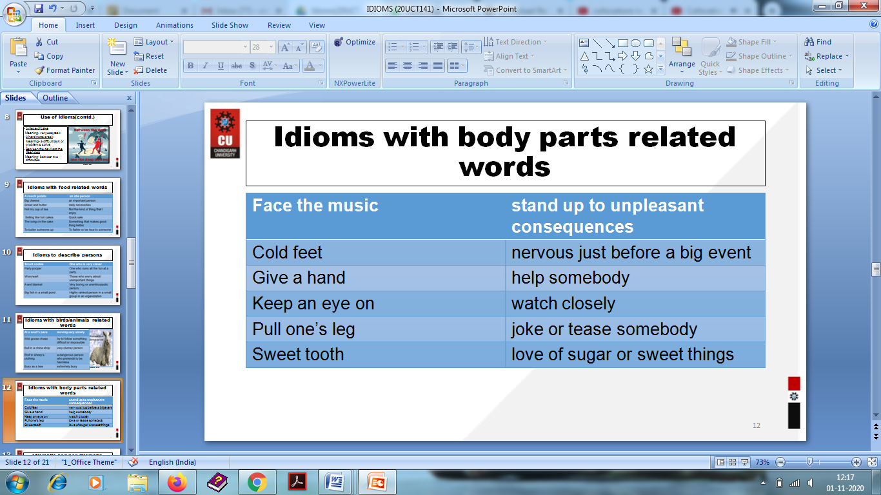
Idioms with body parts related words
Face the music | stand up to unpleasant consequences
Cold feet | nervous just before a big event
Give a hand | help somebody
Keep an eye on | watch closely
Pull one’s leg | joke or tease somebody
Sweet tooth | love of sugar or sweet things

Slide 13
Idiomatic and non idiomatic sentences
a) There is quarrel between two brothers because of this house.
b) This house is an apple of discord between two brothers.
a) He has invited everyone to the party so his wife will keep the house neat and clean by arranging everything nicely at home.
b) He has invited all and sundry to the party so his wife will keep the house spick and span with everything in apple pie order.

Slide 14
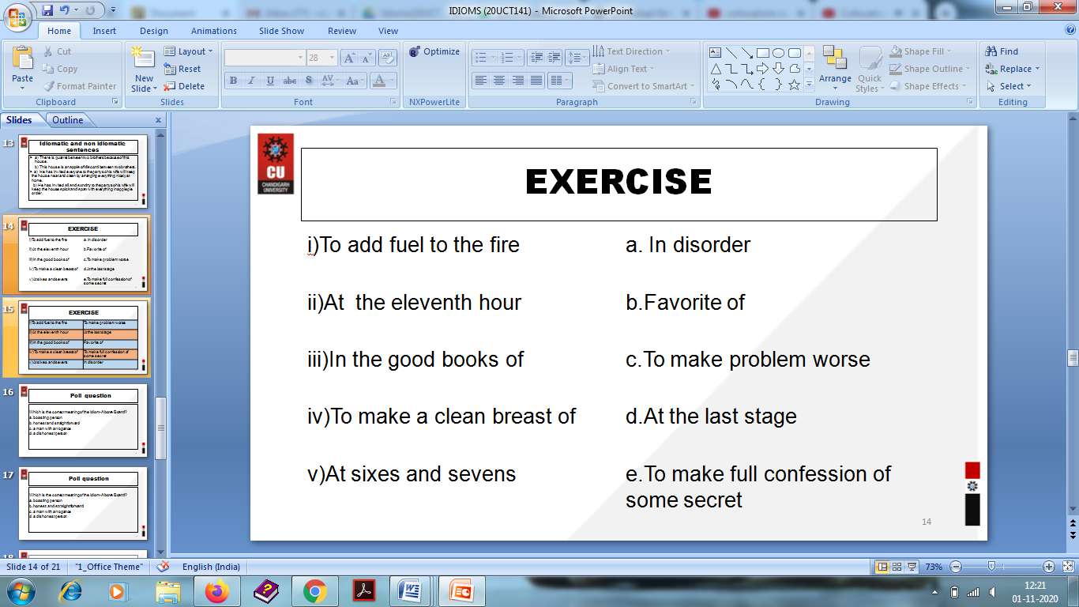
EXERCISE
i)To add fuel to the fire | a. In disorder
ii)At the eleventh hour | b.Favorite of
iii)In the good books of | c.To make problem worse
iv)To make a clean breast of | d.At the last stage
v)At sixes and sevens | e.To make full confession of some secret

Slide 15
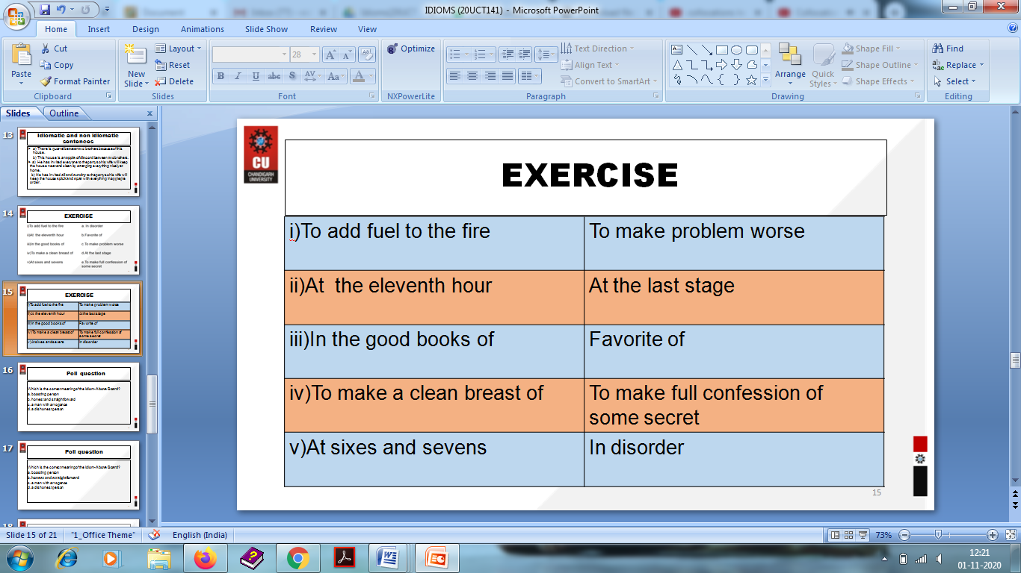
EXERCISE

Slide 16
Poll question
Which is the correct meaning of the idiom- Above Board?
a. boasting person
b. honest and straightforward
c. a man with arrogance
d. a dishonest person

Slide 17
Poll question
Which is the correct meaning of the idiom- Above Board?
a. boasting person
b. honest and straightforward
c. a man with arrogance
d. a dishonest person

Slide 18
Applications
Applicable to professional and personal life
Will strengthen the speaking and writing skills of students with vocabulary usage to make their language figurative
Students will be able to speak variety of effective words so that they will have impressive communication skills

Slide 19
Assessment Pattern
Students are assessed on the basis of the following parameters:
Hourly Tests - 2
Assignments
Surprise Test
Quiz
Student Engagement
End Semester Exam

Slide 20
References
https://www.digitalpolyglot.com/idioms-important-achieve-fluency/
http://www.wordsworthelt.com/blog/importance-teaching-idioms-proverbs-esl-learners/
https://www.bkacontent.com/40-popular-idioms-and-their-meanings/
https://www.fluentu.com/blog/english/english-idioms-6/
Collins Steven, Practical Everyday English: Advanced Vocabulary, Phrasal Verbs, Idioms and Expressions; Montserrat Publishing 2008
Wyatt Rawden, Phrasal Verbs and Idioms, A & C Black Publishers Ltd. Thetford,Norfolk 2006

Slide 21
THANK YOU
For queries
Email: communicationskillsuilah@gmail.com

